Slide 1
Natural Language Processing (Day) 10-Feb-2021
By
B.K.Mishra

Slide 2
Unit-2
Morphology

Slide 3
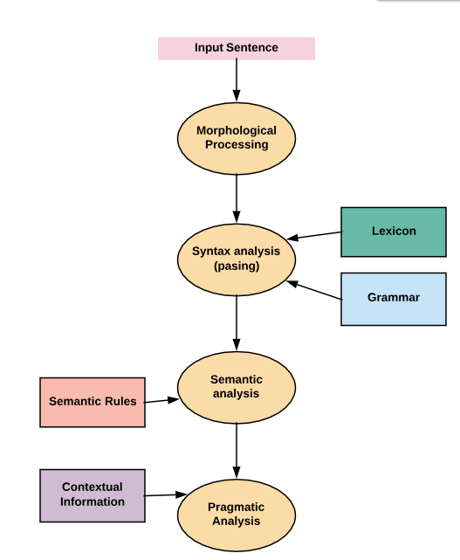

Slide 4
What is Morphology?
Study of Words
Their internal structure
How they are formed?
Morphology tries to formulate rules
washing
wash
-ing
bat
bats
rat
rats
write
writer
browse
browser

Slide 5
Morphology for NLP
Machine Translation
Information Retrieval
goose and geese are two words referring to the same root goose
Analyze
पुस्तक, Noun, Direct Case, Plural
Generate
Transfer
किताबें: किताब, Noun,
Direct Case, Plural
पुस्तके

Slide 6
Need of MA and MG
Why not list all the forms of a word along with their features?
Drink:
drink, V, 1st person
drink, V, 2nd person
drink, V, 3rd person, plural
Drinks: drink, V, 3rd person, singular
Drank: …
Drunk: …
Drinking: …

Slide 7
Need of MA and MG
Reasons:
Productivity: going, drinking, running, playing
Storing every form leads to inefficiency
Addition of new words
Verb: To fax. Forms: fax, faxes, faxed, faxing
Morphological complex languages: Marathi
दारासमोरच्यांनी – दार(SG)+समोर+चा(PL)+नी
Meaning: दरवाजे के सामने वालों ने
Polymorphemic
Possible to store all the forms?

Slide 8
Morphemes
Smallest meaning bearing units constituting a word
Morphemes
Stem
Affixes
Prefixes
Suffixes
tree, go, fat
post - (postpone)
-ed (tossed)
Stem
Prefix
Suffix
reconsideration
re
consider
ation
Affixes in Hindi?

Slide 9
Classes of Morphology
Inflection
Derivation

Slide 10
Inflection
Indicates some grammatical function like
Results in a word of the same class
Productivity
Case | लड़का (D) | लड़के (O)
Number | लड़का (Sg) | लड़के (Pl)
Person | जाऊँगा (1st) | जाओगे (2nd)
Gender | जाऊँगा(Masc) | जाऊँगी (Fem)
Tense | गया(Pas) | जाऊँगी (Fem)

Slide 11
Derivation
Usually, results in a word of a different class
-able when attached to a verb gives an adjective
read (V) + -able = readable (Adj)
Often meaning of the derived word is difficult to predict exactly
writer :: writer (one who writes)
paint :: painter (one who paints)
cut :: cutter? (an instrument used to cut)
Less productive
eatable :: readable :: runnable?

Slide 12
Problems in MA
Productivity
False Analysis
Bound Base Morphemes

Slide 13
Productivity
Property of a morphological process to give rise to new formations on a systematic basis
Exceptions
Transitive Verb (read)
-able
Productive (readable)
Noun (game)
-able
Not Productive (gameable)
Peaceable | Actionable | Companionable
Saleable | Marriageable | Reasonable
Impressionable | Fashionable | knowledgeable

Slide 14
False analysis
hospitable, sizeable
They don’t have the meaning “to be able”
They can not take the suffix -ity to form a noun
Analyzing them as the words containing suffix -able leads to false analysis

Slide 15
Bound Base Morphemes
Occur only in a particular complex word
Do not have independent existence
base (nonexistent)
morpheme (known)
Compound
malleable
feasible (fease+ible)
-able has the regular meaning “be able”
-ity form is possible
Base words don’t exit independently

Slide 16
More on Inflection
Noun inflectional suffixes | Plural marker -s Possessive marker ‘s
Verb inflectional suffixes | Third person present singular marker -s Past tense marker -ed Progressive marker -ing Past participle markers -en or –ed
Adjective inflectional suffixes | Comparative marker -er Superlative marker -est
Inflectional Suffixes in English

Slide 17
Spelling Rules
Generally words are pluralized by adding –s to the end
Words ending in –s, -z, -sh and sometimes –x require –es
buses, quizzes, dishes, boxes
Nouns ending in –y preceded by a consonant change the –y to -i
babies, floppies

Slide 18
Verbal Inflection
Morphological Form Classes | Regularly Inflected Verbs |  |  |  | Irregularly Inflected Verbs
Stem | Jump | Parse | Fry | Sob | Eat | Bring | Cut
-s form | Jumps | Parses | Fries | Sobs | Eats | Brings | Cuts
-ing participle | Jumping | Parsing | Frying | Sobbing | Eating | Bringing | Cutting
Past form | Jumped | Parsed | Fried | Sobbed | Ate | Brought | Cut
–ed participle | Jumped | Parsed | Fried | Sobbed | Eaten | Brought | Cut
Forms governed by spelling rules
Idiosyncratic forms

Slide 19
Morphological Parsing
Finding
Constituent morphemes
Features
Input | Morphological Parsed Output
cats | cat +N +PL
geese | goose +N +PL
goose | (goose +N +SG) or (goose +V)
gooses | goose +V +3G
caught | (catch +V +PAST-PART) or (catch +V +PAST)

Slide 20
Resources
Lexicon | List of stems and suffixes along with basic information about them
Morphotactics | A model of morpheme ordering that explains which classes of morphemes can follow other classes of morphemes
Orthographic Rules | Spelling rules used to model the changes that occur in the work usually when two morphemes combine

Slide 21
Morphological Recognition
reg-noun | irregular-sg-noun | irregular-pl-noun | plural
flower | goose | geese | -s
cat | sheep | sheep
dog | mouse | mice
Lexicon

Slide 22
Morphological Recognition: Nouns
reg-noun | irregular-sg-noun | irregular-pl-noun | plural
flower | goose | geese | -s
cat | sheep | sheep
dog | mouse | mice
Lexicon
reg-noun
plural (-s)
q0
q1
q2
FSA
Note: Here, we are ignoring the nouns which take the suffix –es for pluralization
irreg-pl-noun
irreg-sg-noun

Slide 23
Adjectives
Type | Properties | Examples
adj-root1 | Occur with un- and -ly | happy, real
Adj-root2 | Can’t occur with un- and -ly | big, red

Slide 24
Adjectives
Type | Properties | Examples
adj-root1 | Occur with un- and -ly | happy, real
Adj-root2 | Can’t occur with un- and -ly | big, red
adj-root1
-er
-ly
-est
q1
q2
un-
q0
q5
adj-root1
ε
q3
q4
-er
-est
adj-root2

Slide 25
References
“Linguistics, An Introduction to Language and Communication” by Adrian Akmajian, Richard A. Demers, Ann K. Farmer and Robert M. Harnish (5th Edition)
SPEECH and LANGUAGE PROCESSING, An Introduction to Natural Language Processing, Computational Linguistics, and Speech Recognition by Daniel Jurafsky and James H. Martin (Second Edition)

Slide 27
Regular Expressions
In computer science, RE is a language used for specifying text search string.
A regular expression is a formula in a special language that is used for specifying a simple class of string.
Formally, a regular expression is an algebraic notation for characterizing a set of strings.
RE search requires
a pattern that we want to search for, and
a corpus of texts to search through.

Slide 28
Regular Expressions
A RE search function will search through the corpus returning all texts that contain the pattern.
In a Web search engine, they might be the entire documents or Web pages.
In a word-processor, they might be individual words, or lines of a document. (We take this paradigm.)
E.g., the UNIX grep command

Slide 29
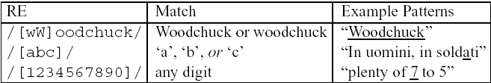
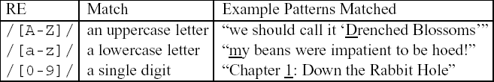
Regular Expressions Basic Regular Expression Patterns
The use of the brackets [] to specify a disjunction of characters.
The use of the brackets [] plus the dash - to specify a range.

Slide 30
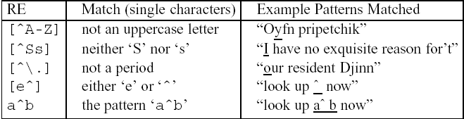

Regular Expressions Basic Regular Expression Patterns
Uses of the caret ^ for negation or just to mean ^
The question-mark ? marks optionality of the previous expression.
The use of period . to specify any character

Slide 31
Regular Expressions Disjunction, Grouping, and Precedence
Disjunction
/cat|dog
Precedence
/gupp(y|ies)
Operator precedence hierarchy
()
+ ? { }
the ^my end$
|

Slide 32
Regular Expressions A Simple Example
To find the English article the
/the/
/[tT]he/
/\b[tT]he\b/
/[^a-zA-Z][tT]he[^a-zA-Z]/
/^|[^a-zA-Z][tT]he[^a-zA-Z]/

Slide 33
Regular Expressions A More Complex Example
“any PC with more than 500 MHz and 32 Gb of disk space for less than $1000”
/$[0-9]+/
/$[0-9]+\.[0-9][0-9]/
/\b$[0-9]+(\.[0-9][0-9])?\b/
/\b[0-9]+ *(MHz|[Mm]egahertz|GHz|[Gg]igahertz)\b/
/\b[0-9]+ *(Mb|[Mm]egabytes?)\b/
/\b[0-9](\.[0-9]+)? *(Gb|[Gg]igabytes?)\b/
/\b(Win95|Win98|WinNT|Windows *(NT|95|98|2000)?)\b/
/\b(Mac|Macintosh|Apple)\b/

Slide 34
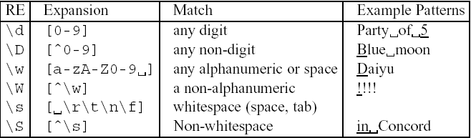
Regular Expressions Advanced Operators
Aliases for common sets of characters

Slide 35
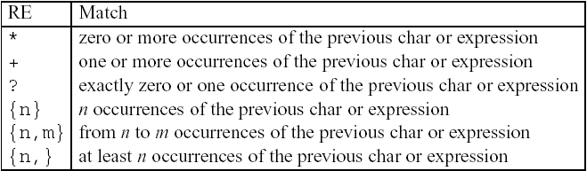
Regular Expressions Advanced Operators
Regular expression operators for counting

Slide 36
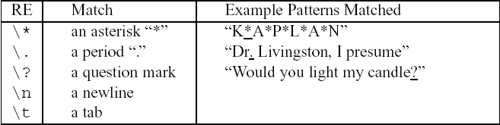
Regular Expressions Advanced Operators
Some characters that need to be backslashed

Slide 37
Regular Expressions Regular Expression Substitution, Memory, and ELIZA
s/regexp1/regexp2/
E.g. the 35 boxes → the <35> boxes
s/([0-9]+)/<\1>/
The following pattern matches “The bigger they were, the bigger they will be”, not “The bigger they were, the faster they will be”
/the (.*)er they were, the\1er they will be/
The following pattern matches “The bigger they were, the bigger they were”, not “The bigger they were, the bigger they will be”
/the (.*)er they (.*), the\1er they \2/
registers

Slide 38
Regular Expressions Regular Expressions Substitution, Memory, and ELIZA
Eliza worked by having a cascade of regular expression substitutions that each match some part of the input lines and changed them
my → YOUR, I’m → YOU ARE …
s/.* YOU ARE (depressed|sad) .*/I AM SORRY TO HEAR YOU ARE \1/
s/.* YOU ARE (depressed|sad) .*/WHY DO YOU THINK YOU ARE \1/
s/.* all .*/IN WHAT WAY/
s/.* always .*/CAN YOU THINK OF A SPECIFIC EXAMPLE/
User₁: Men are all alike.
ELIZA₁: IN WHAT WAY
User₂: They’re always bugging us about something or other.
ELIZA₂: CAN YOU THINK OF A SPECIFIC EXAMPLE
User₃: Well, my boyfriend made me come here.
ELIZA₃: YOUR BOYBRIEND MADE YOU COME HERE
User₄: He says I’m depressed much of the time.
ELIZA₄: I AM SORRY TO HEAR YOU ARE DEPRESSED

Slide 39
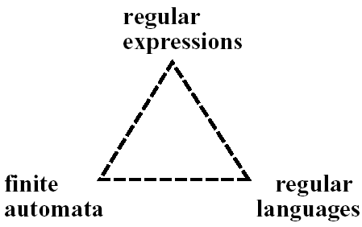
Finite-State Automata
An RE is one way of describing a FSA.
An RE is one way of characterizing a particular kind of formal language called a regular language.

Slide 40
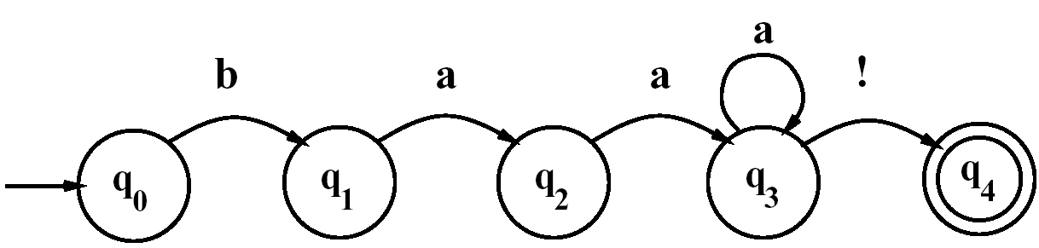
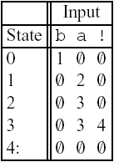
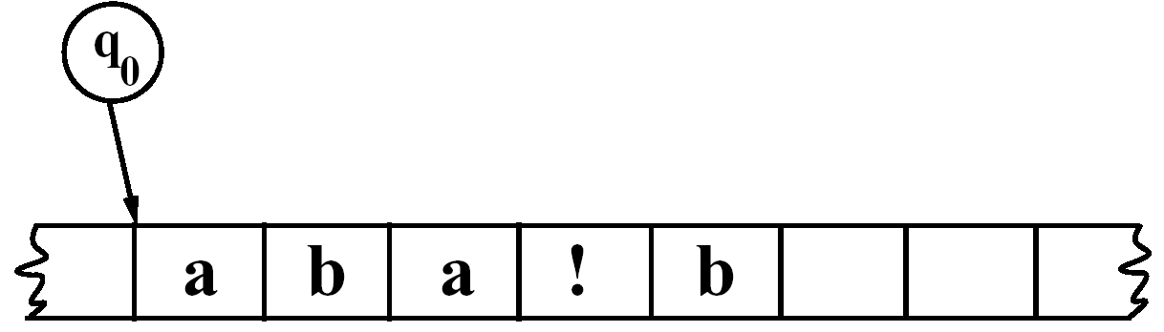
Finite-State Automata Using an FSA to Recognize Sheeptalk
/baa+!/
The transition-state table
A tape with cells
Automaton (finite automaton, finite-state automaton (FSA))
State, start state, final state (accepting state)

Slide 41
Finite-State Automata Using an FSA to Recognize Sheeptalk
A finite automaton is formally defined by the following five parameters:
Q: a finite set of N states q₀, q₁, …, q_{N}
Σ: a finite input alphabet of symbols
q₀: the start state
F: the set of final states, F ⊆ Q
δ(q,i): the transition function or transition matrix between states. Given a state q ∈ Q and input symbol i ∈ Σ, δ(q,i) returns a new state q’ ∈ Q. δ is thus a relation from Q × Σ to Q;

Slide 42
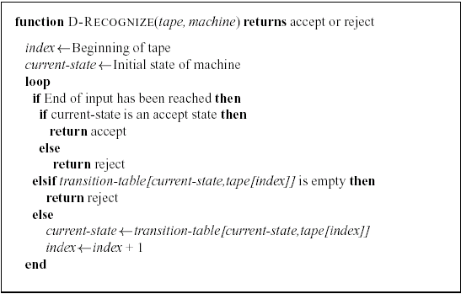
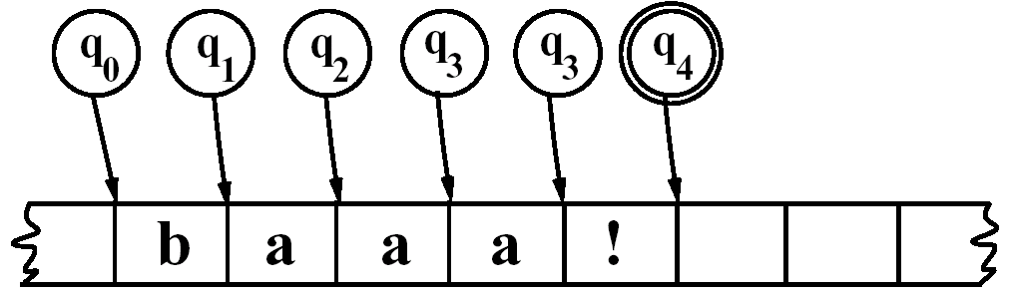
Finite-State Automata Using an FSA to Recognize Sheeptalk
An algorithm for deterministic recognition of FSAs.

Slide 43
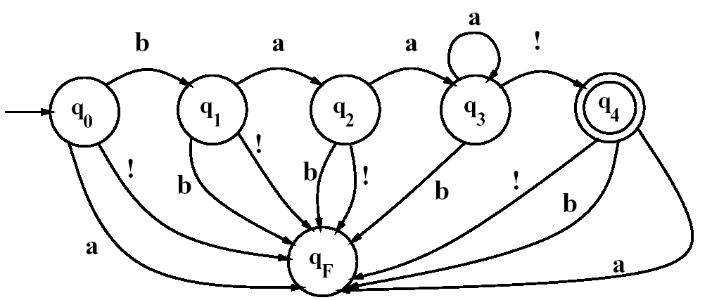
Finite-State Automata Using an FSA to Recognize Sheeptalk
Adding a fail state

Slide 44
Finite-State Automata Formal Languages
Key concept #1: Formal Language: A model which can both generate and recognize all and only the strings of a formal language acts as a definition of the formal language.
A formal language is a set of strings, each string composed of symbols from a finite symbol-set call an alphabet.
The usefulness of an automaton for defining a language is that it can express an infinite set in a closed form.
A formal language may bear no resemblance at all to a real language (natural language), but
We often use a formal language to model part of a natural language, such as parts of the phonology, morphology, or syntax.
The term generative grammar is used in linguistics to mean a grammar of a formal language.

Slide 45
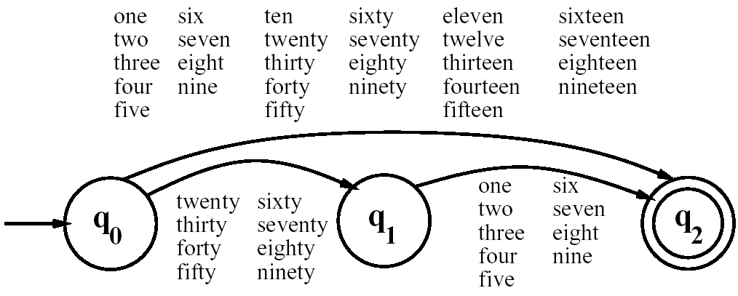
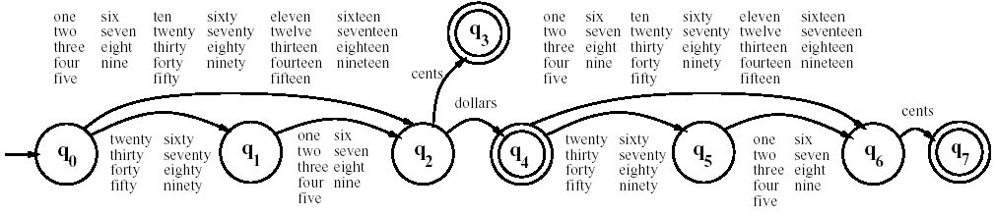
Finite-State Automata Another Example
An FSA for the words of English numbers 1-99
FSA for the simple dollars and cents

Slide 46
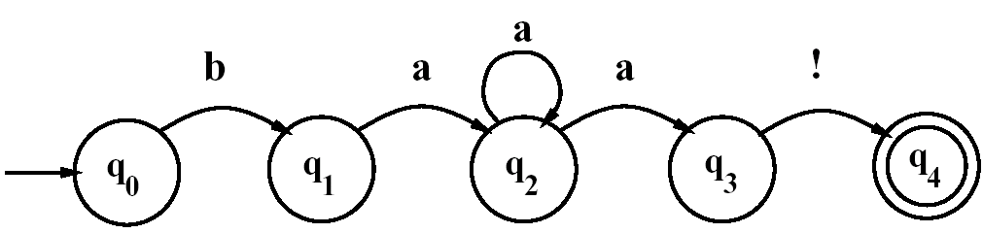
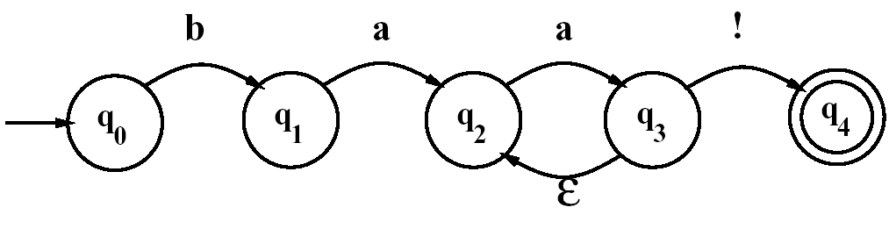
Finite-State Automata Non-Deterministic FSAs

Slide 47

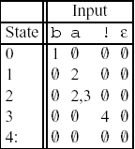
Finite-State Automata Using an NFSA to Accept Strings
Solutions to the problem of multiple choices in an NFSA
Backup
Look-ahead
Parallelism

Slide 48
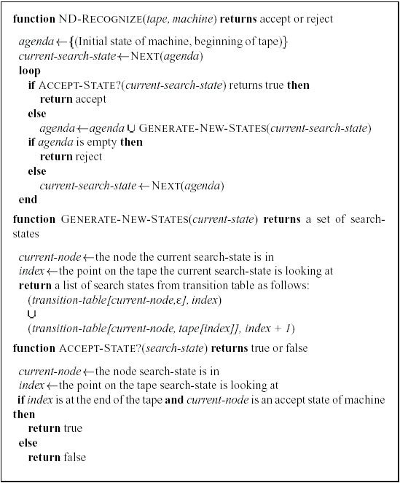
Finite-State Automata Using an NFSA to Accept Strings

Slide 49
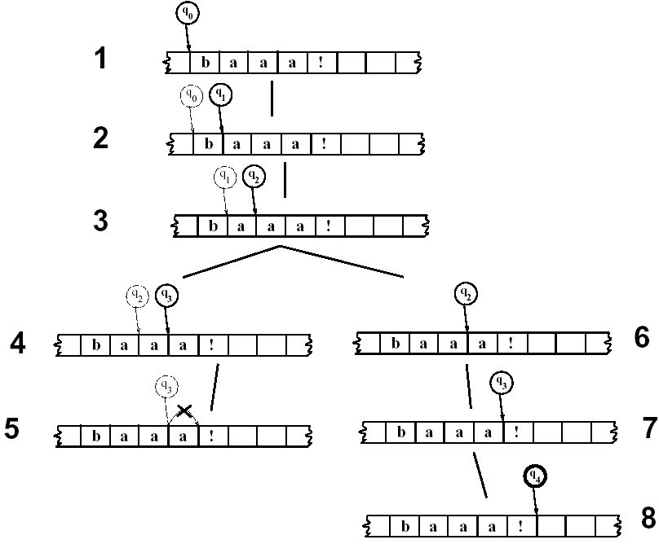
Finite-State Automata Using an NFSA to Accept Strings

Slide 50
Finite-State Automata Recognition as Search
Algorithms such as ND-RECOGNIZE are known as state-space search
Depth-first search or Last In First Out (LIFO) strategy
Breadth-first search or First In First Out (FIFO) strategy
More complex search techniques such as dynamic programming or A*

Slide 51
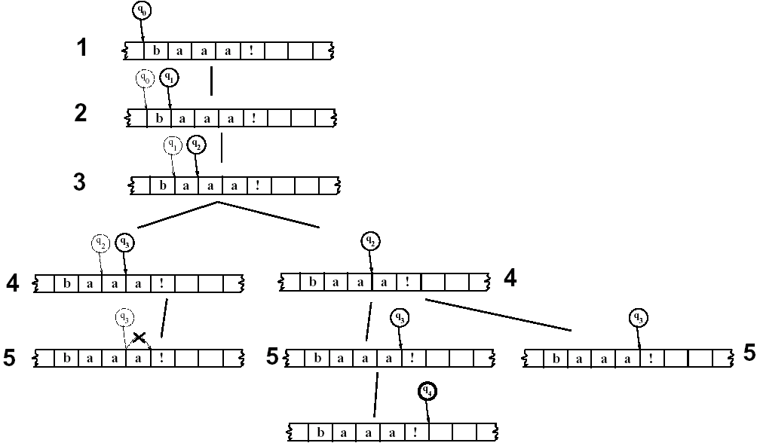
Finite-State Automata Recognition as Search
A breadth-first trace of FSA #1 on some sheeptalk

Slide 52
Regular Languages and FSAs
The class of languages that are definable by regular expressions is exactly the same as the class of languages that are characterizable by FSA (D or ND).
These languages are called regular languages.
The regular languages over Σ is formally defined as:
φ is an RL
∀a ∈ Σ, {a} is an RL
If L₁ and L₂ are RLs, then so are:
L₁⋅L₂ ={xy| x ∈ L₁ and y ∈ L₂}, the concatenation of L₁ and L₂
L₁∪L₂, the union of L₁ and L₂
L₁*, the Kleene closure of L₁

Slide 53
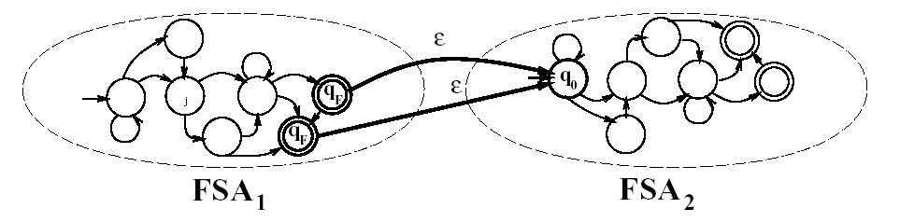
Regular Languages and FSAs
The concatenation of two FSAs

Slide 54
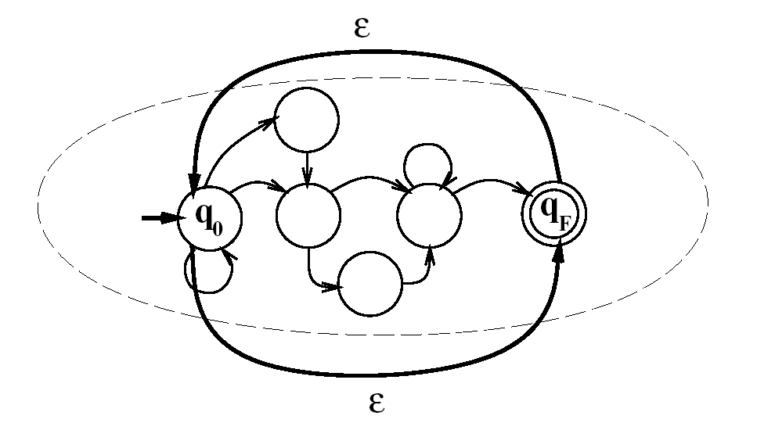
Regular Languages and FSAs
The closure (Kleene *) of an FSAs

Slide 55
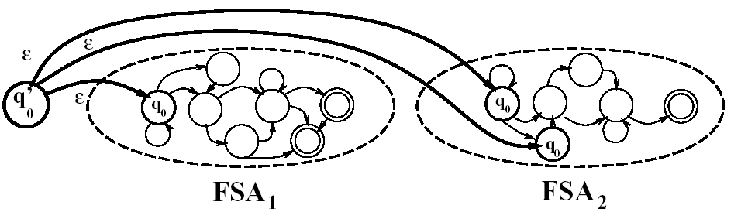
Regular Languages and FSAs
The union (|) of two FSAs

